Slide 1

EQUIFAX, INC (NYSE: EFX)
1

Slide 2
Summary
My recommendation is to go long shares of EFX, on the basis that the company has shown a commitment to increasing margins along with the relative outperformance of the mortgage market and its underestimated rebound
Price Target: $304.80 Time Target: 3 Years
Expect revenues to grow 9.72% CAGR over the next 5 years and ADJ. EBITDA margins to expand by ~570 bps
1
2
3
Strong non-mortgage growth and new products in workforce solutions will offset the depressed mortgage market
Equifax revenues have consistently outperformed the underlying mortgage market over recent years.
Increasing margins and shifting more than half of revenue to workforce solutions
Attainable goal in 3-5 years of $7B top line revenue with 39% Adjusted EBITDA margins
Management focused on reducing costs
The rebound of the mortgage market is underestimated
Realistic path towards 5-6% rates in the next 3-5 years and a return to pre-pandemic average
2015-19 levels targeted by 2028

Slide 3
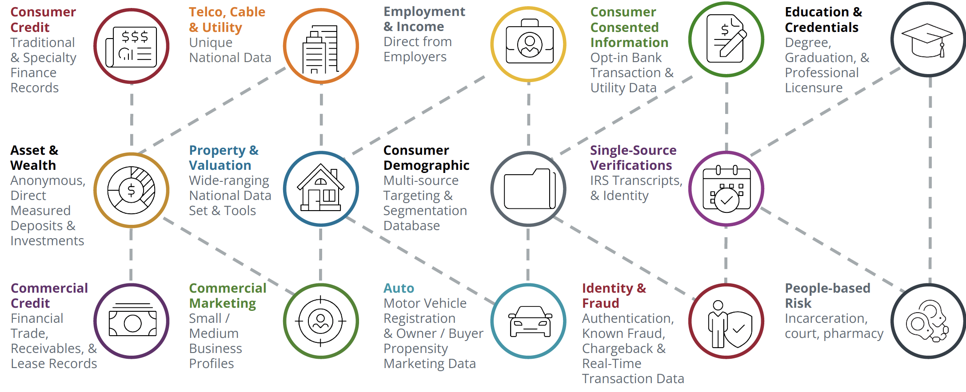
EFX Overview
Business Overview
Snapshot
Founded: 1899 Employees: 14K TTM Revenue: $2.264B TTM Adj. EBITDA: $1.618B Market Cap: $26.263B EV: $31.638B (18.6x Adj. TTM EBITDA) Stock Price (as of 11/28): $213.1 52-Week Range: $159.95 – $240.35 Next Earnings Date: 02/07/2024
2022 Segment Overview
$M | WORKFORCE SOLUTIONS | % | US INFORMATION SYSTEMS | % | INTERNATIONAL | %
Revenue | $2325.4 | 100% | $1657.7 | 100% | $1139.1 | 100%
Adj. EBITDA | $1193.5 | 51.3% | $609.7 | 36.8% | $292.6 | 25.7%
Operating Income | $1006 | 43.3% | $402.1 | 24.3% | $147 | 12.9%
One of the three major credit bureaus
Main products are credit information and verifications
Diverse blend of data, analytics, and technology.
Applying for a job, mortgage, student loan, auto.

Slide 4
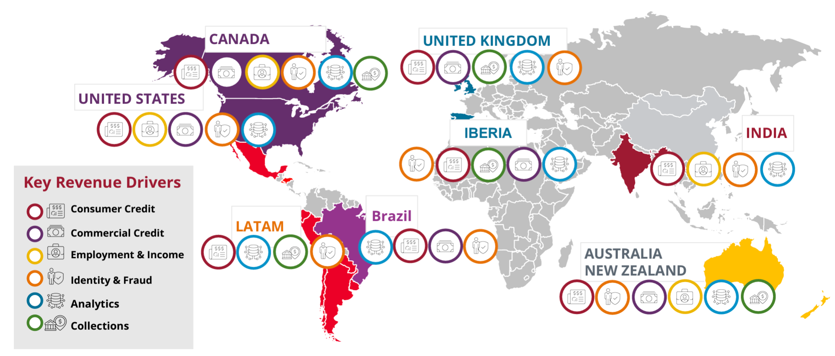
Company Segments
Workforce Solutions
Verification Services Employer Services
- VOI - Tax
- VOE - HR
- Education history - I-9
- Criminal history - W-9
- Healthcare licensure - W-4
The Work Number (TWN) is the most popular product
- Income and Employment Verification
- Over 163M employee records (Largest in the industry)
- 2.8M Contributors (50% Direct/50% Partner)
Customers
Mortgage – 33%
Government – 15%
Talent Solutions – 14%
U.S. Information Systems
Online Information Solutions
- Consumer Information (Credit Reports)
- Identity Verification
- Fraud Management
Mortgage Solutions
- Tri-Merge Reports
- Early Warning Services
Financial Marketing Services
- Portfolio Management
- Analytical Services
- Marketing Services
International
Asia-Pacific Europe
Latin America Canada

Slide 5
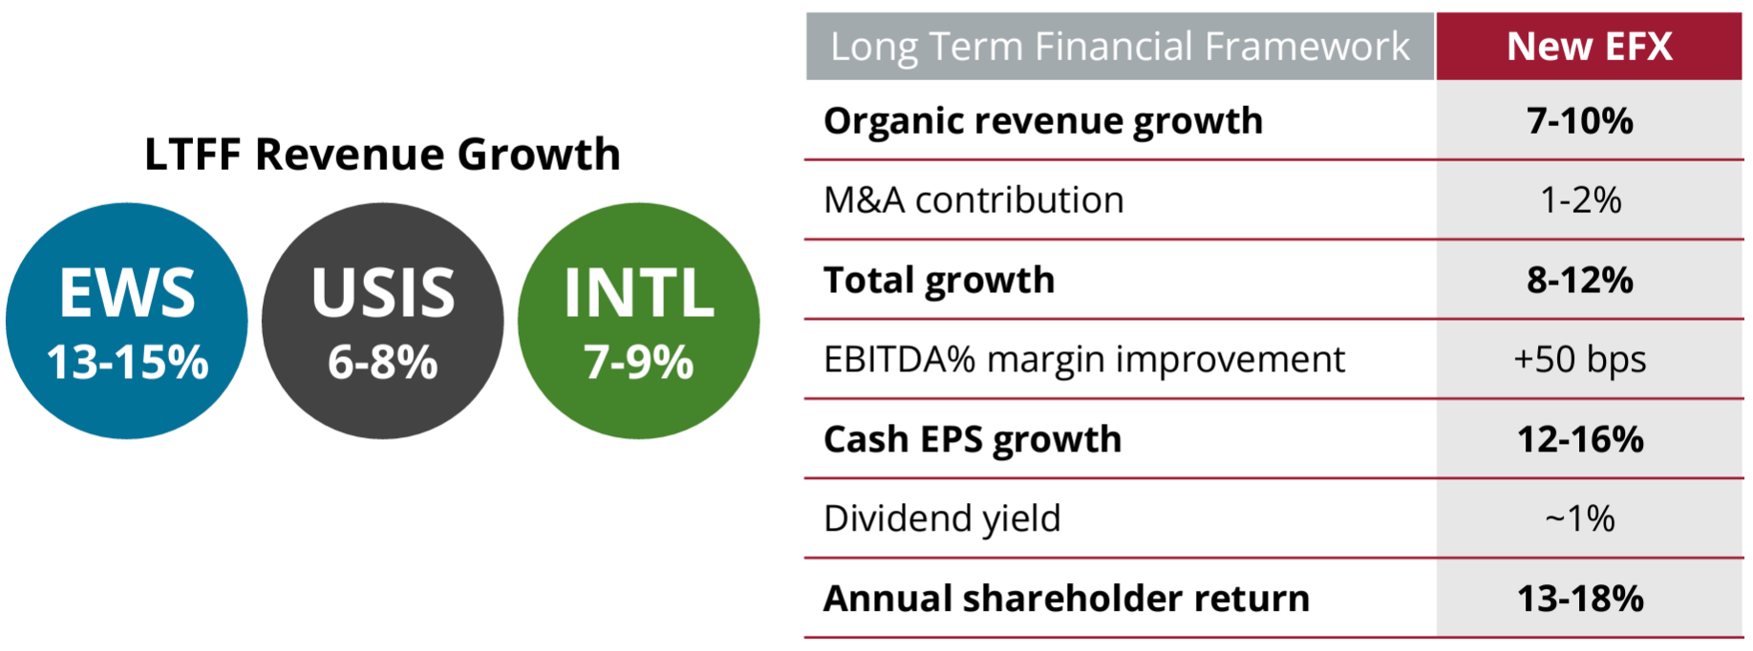
Investment Opportunity
“Although the unprecedented decline in the U.S. mortgage market in 2022 and 2023, pushes out our prior midterm goal of $7 billion in revenue and 39% EBITDA margins to beyond 2025, it does not change our focus on expanding our margins toward our 39% goal as we drive revenue higher.” – John W. Gamble, CFO Equifax ’23 Q3 Earnings Call

Slide 6
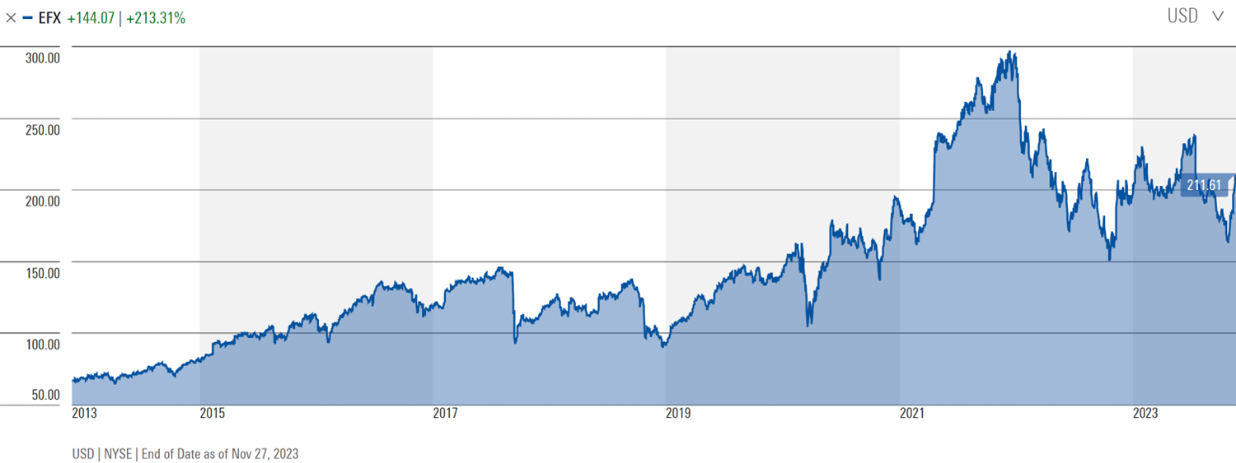
10 YEAR PRICE HISTORY
-48% SELL OFF
34% CAGR
25% CAGR

Slide 7
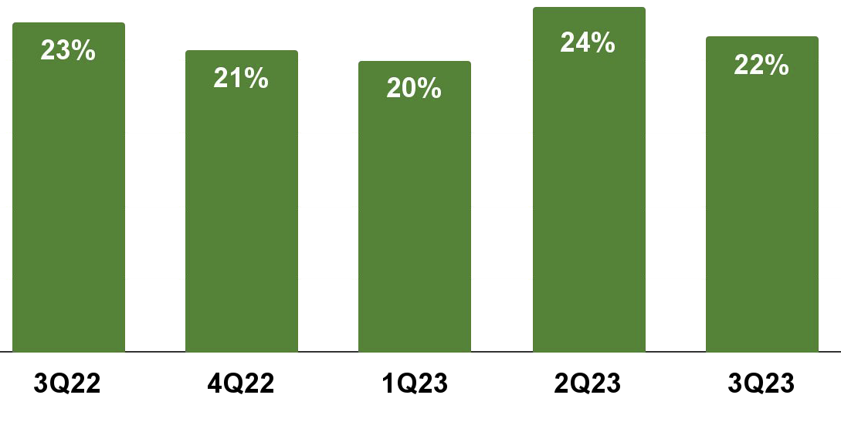
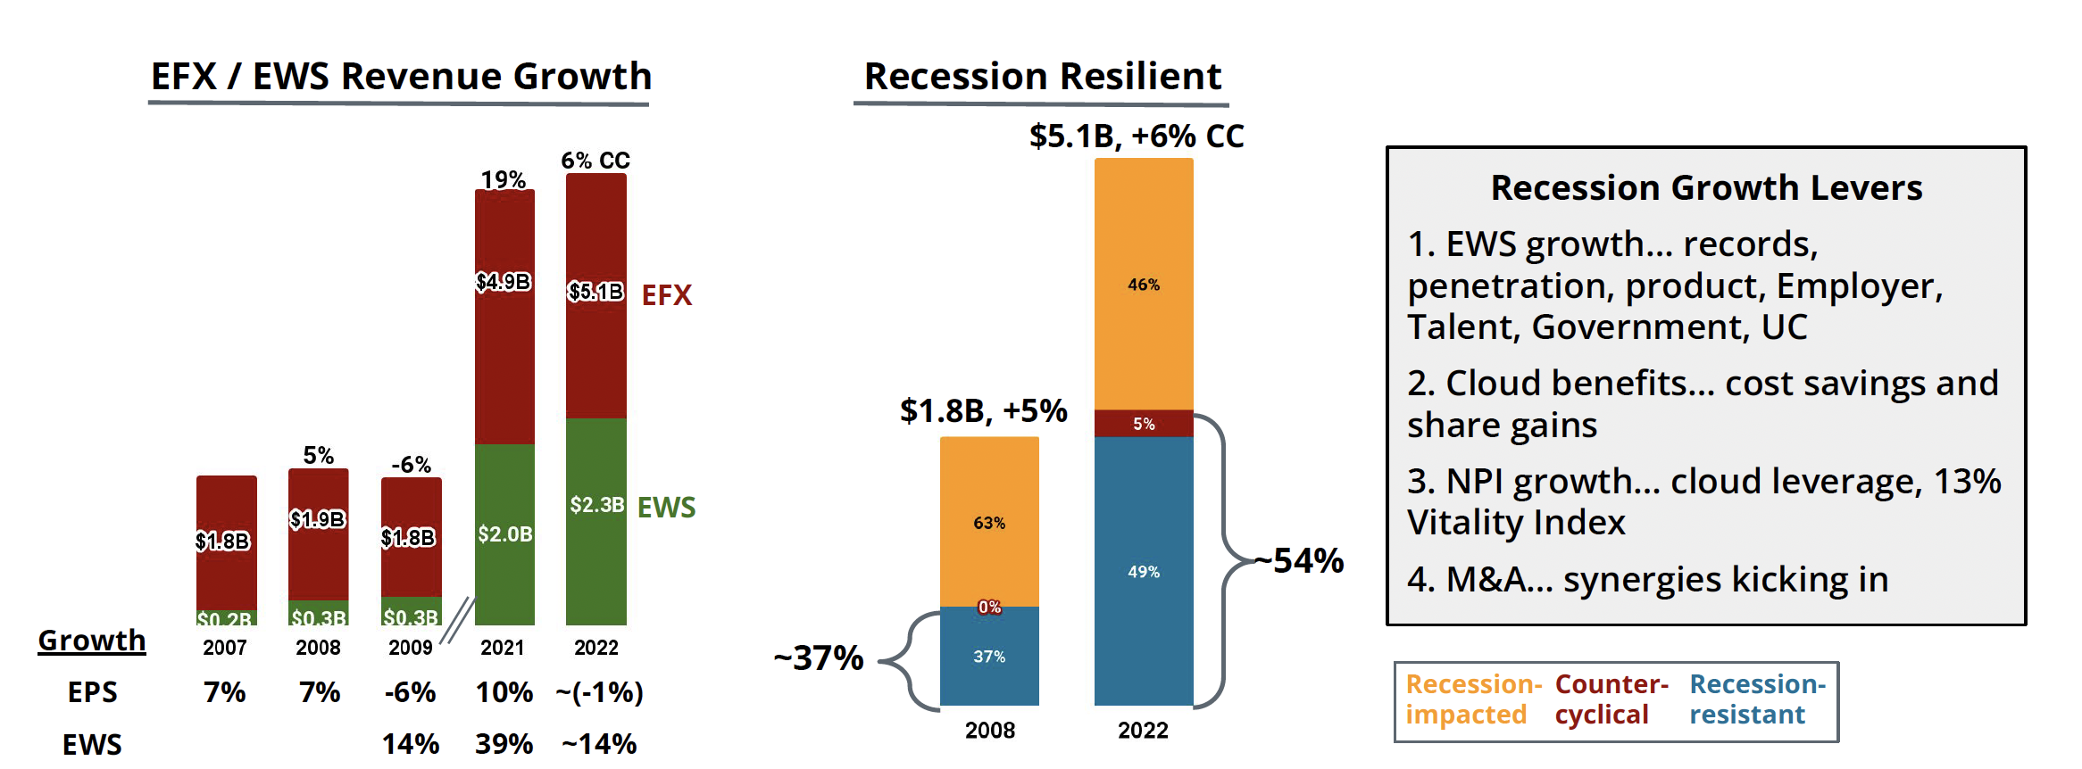
Thesis 1: Strong non-mortgage organic growth is sustaining revenues in EWS
Resistance to poor mortgage market conditions
Consistent outperformance
Market dominance with Verification Services
TWN is a market leader and continues to grow
11% EWS non-mortgage growth
Government +23% Q3
Large TAM
Employer revenue up +13% total, +9% organic
I9 / Onboarding +25% / +17% Organic
Long-Term Growth Framework of 13-15%
Continued Mortgage Outperformance
Mortgage -15%, with 22 pts of mortgage outperformance

Slide 8
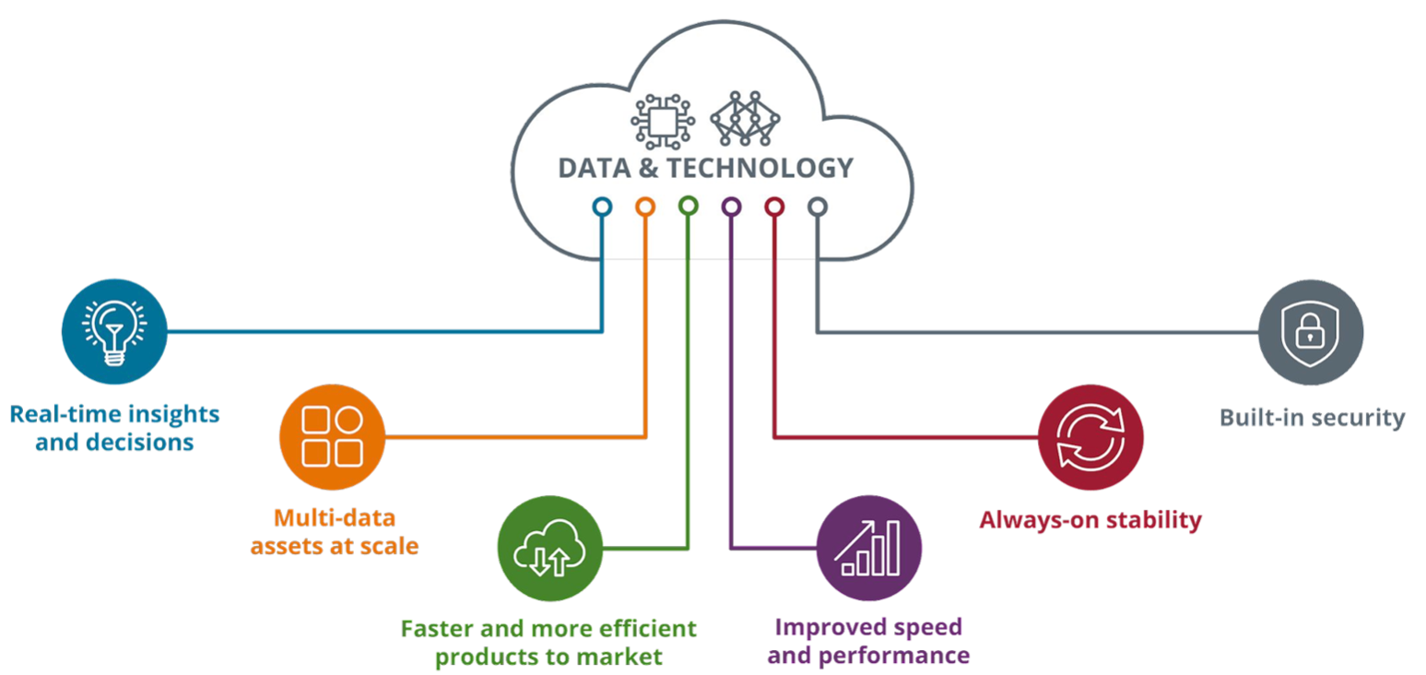
Thesis 2: Management remains focused on reducing margins
Path to 39%
50% of Revenue from EWS
Workforce solutions is the highest margin segment at 50%
Management predicts 50 bps yoy margin growth
Move to the cloud has made the segment more efficient
$210M spending reduction in 2023 and $275M reduction in 2024
Data breaches and lawsuits are largely behind the company
Equifax is now an industry leader in data security

Slide 9
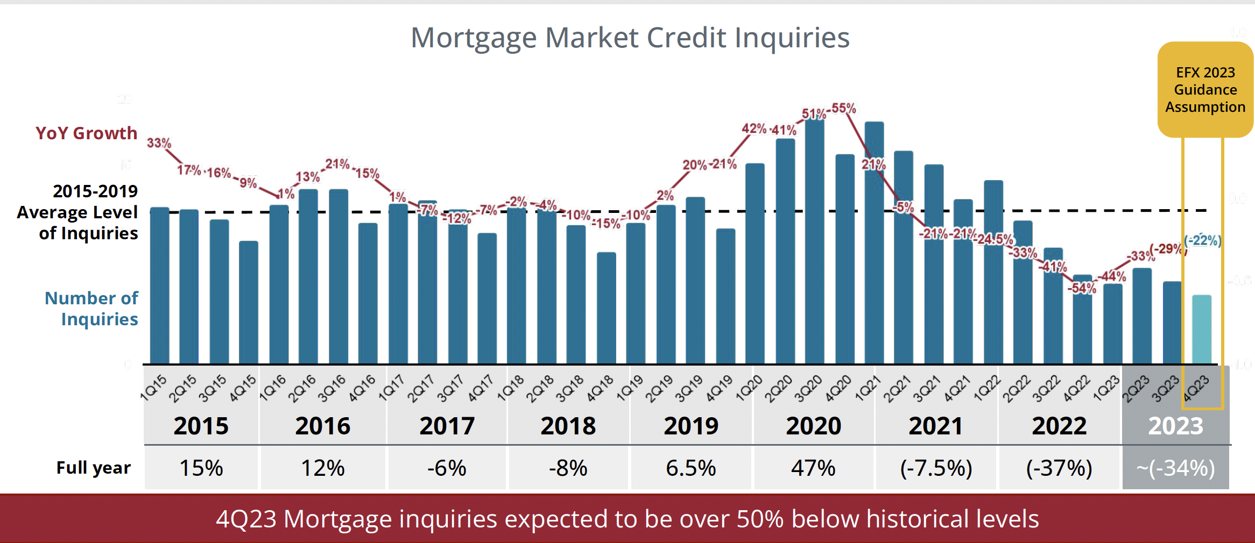
Thesis 3: Rebound in the mortgage industry is underestimated
Management has made these growth assumptions with poor market conditions in mind
They predict levels to return to 2015-19 averages in the next 3-5 years
There is a realistic path to that recovery
Rate hikes have likely stopped
However still “higher for longer”
Won’t get back down to 4% but 5-6% rates in 2-3 years is achievable
Spread to 10 Year Treasury will regress to mean
Current spread is 3%, mean over last 25 years has been 1.85%
Spread has increased due to inverted yield curve and prepayment risk
Rates at that level would support a recovery to pre-pandemic averages

Slide 10
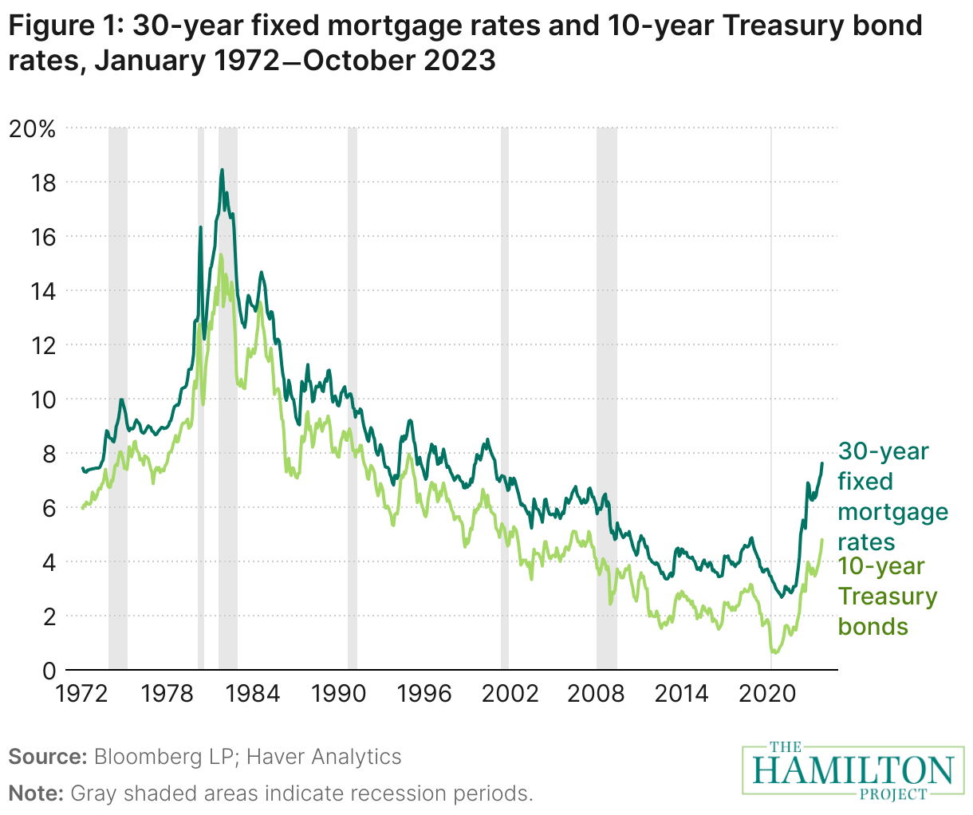
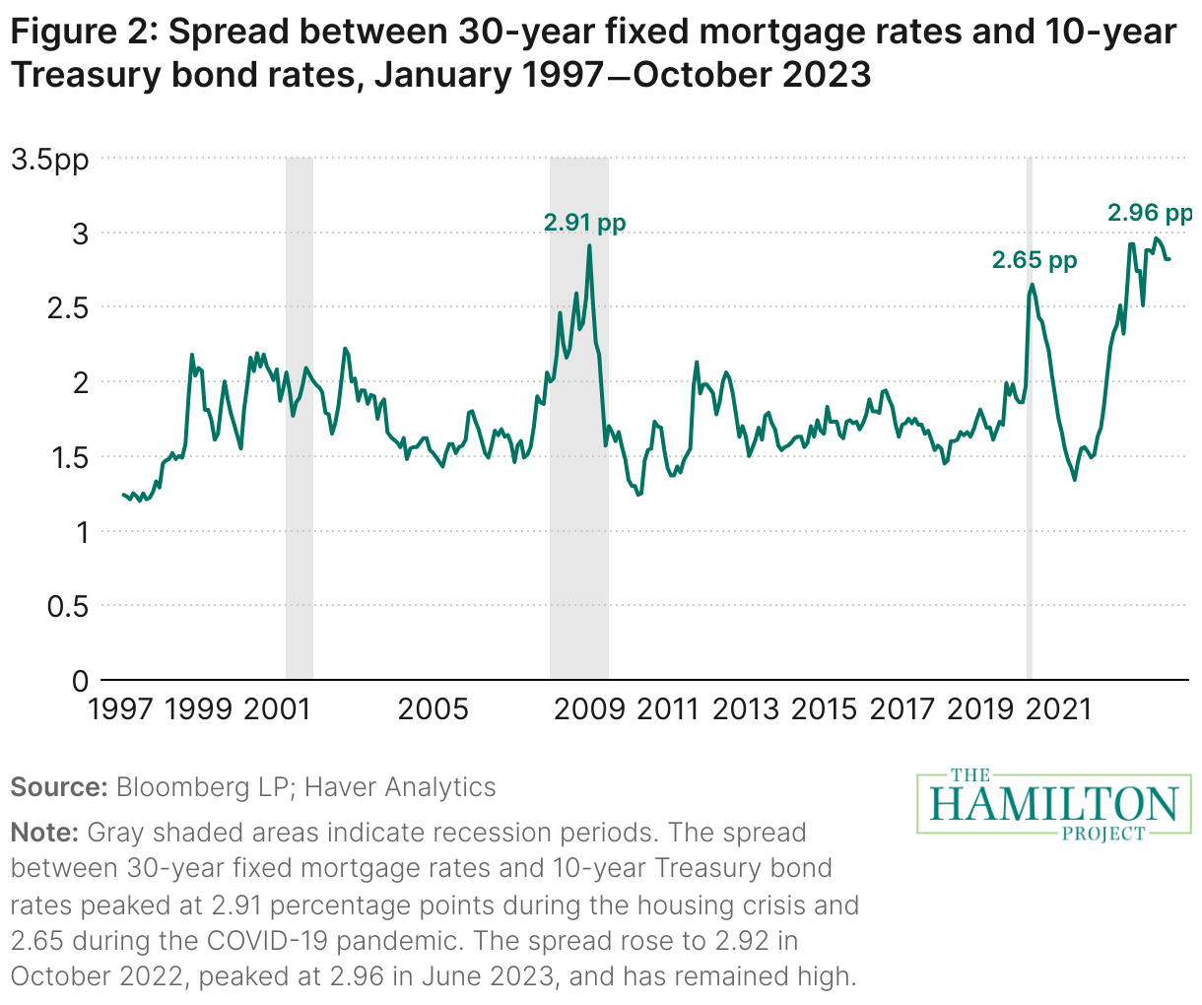

Slide 11

MBA Mortgage Finance Forecast
November 17, 2023
2023
2024
2025
Q1 | Q2 | Q3 | Q4 | Q1 | Q2 | Q3 | Q4 | Q1 | Q2 | Q3 | Q4 | 2023 | 2024 | 2025 | 2026
1,385 | 1,450 | 1,359 | 1,375 | 1,358 | 1,342 | 1,351 | 1,378 | 1,407 | 1,447 | 1,468 | 1,482 | 1,392 | 1,357 | 1,451 | 1,440
834 | 930 | 961 | 983 | 992 | 1,008 | 1,030 | 1,068 | 1,105 | 1,131 | 1,156 | 1,174 | 927 | 1,025 | 1,142 | 1,135
552 | 520 | 398 | 392 | 366 | 334 | 321 | 310 | 302 | 316 | 312 | 308 | 465 | 333 | 310 | 305
4,327 | 4,250 | 4,023 | 4,043 | 4,149 | 4,301 | 4,480 | 4,655 | 4,788 | 4,824 | 4,920 | 4,904 | 4,161 | 4,397 | 4,859 | 4,935
638 | 691 | 724 | 732 | 743 | 749 | 763 | 762 | 783 | 795 | 802 | 810 | 696 | 754 | 797 | 796
4.6 | 3.1 | 5.0 | 5.7 | 5.7 | 5.3 | 4.7 | 4.1 | 3.6 | 3.4 | 3.2 | 3.3 | 5.7 | 4.1 | 3.3 | 3.9
366.7 | 397.5 | 401.4 | 397.1 | 398.0 | 398.1 | 394.1 | 393.8 | 394.5 | 394.9 | 395.4 | 396.1 | 390.7 | 396.0 | 395.1 | 394.3
434.8 | 418.7 | 428.9 | 425.8 | 428.6 | 432.2 | 431.9 | 432.8 | 434.7 | 437.2 | 439.5 | 441.8 | 427.0 | 431.4 | 438.3 | 432.0
6.4 | 6.5 | 7.0 | 7.5 | 7.1 | 6.6 | 6.3 | 6.1 | 5.9 | 5.8 | 5.6 | 5.5 | 7.5 | 6.1 | 5.5 | 5.4
3.6 | 3.6 | 4.2 | 4.6 | 4.3 | 4.0 | 3.8 | 3.7 | 3.7 | 3.7 | 3.6 | 3.6 | 4.6 | 3.7 | 3.6 | 3.6
333 | 463 | 444 | 399 | 429 | 525 | 543 | 523 | 501 | 619 | 620 | 598 | 1,639 | 2,020 | 2,339 | 2,436
267 | 371 | 363 | 324 | 330 | 410 | 408 | 382 | 346 | 461 | 456 | 436 | 1,325 | 1,530 | 1,699 | 1,782
66 | 92 | 81 | 75 | 99 | 116 | 135 | 140 | 155 | 158 | 164 | 162 | 314 | 490 | 639 | 654
20 | 20 | 18 | 19 | 23 | 22 | 25 | 27 | 31 | 26 | 27 | 27 | 19 | 24 | 27 | 27
 |  |  |  |  |  |  |  |  |  |  |  | 197 | 221 | 233 | 224
895 | 1,239 | 1,165 | 1,034 | 1,107 | 1,335 | 1,372 | 1,315 | 1,260 | 1,526 | 1,519 | 1,457 | 4,333 | 5,129 | 5,761 | 5,797
686 | 948 | 913 | 804 | 807 | 989 | 974 | 904 | 811 | 1,072 | 1,050 | 997 | 3,350 | 3,674 | 3,930 | 3,986
210 | 291 | 252 | 230 | 300 | 346 | 399 | 411 | 448 | 454 | 469 | 460 | 983 | 1,455 | 1,831 | 1,811
23 | 23 | 22 | 22 | 27 | 26 | 29 | 31 | 36 | 30 | 31 | 32 | 23 | 28 | 32 | 31
13,671 | 13,767 | 13,822 | 13,879 | 13,931 | 13,988 | 14,050 | 14,117 | 14,190 | 14,264 | 14,343 | 14,425 | 13,879 | 14,117 | 14,690 | 14,783
Housing Measures
Housing Starts (SAAR, Thous) Single-Family
Two or More
Home Sales (SAAR, Thous) Total Existing Homes
New Homes
FHFA US House Price Index (YOY % Change) Median Price of Total Existing Homes (Thous $) Median Price of New Homes (Thous $)
Interest Rates
30-Year Fixed Rate Mortgage (%) 10-Year Treasury Yield (%)
Mortgage Originations
Total 1- to 4-Family (Bil $) Purchase
Refinance
Refinance Share (%) FHA Originations (Bil $)
Total 1- to 4-Family (000s loans) Purchase
Refinance
Refinance Share (%)
Mortgage Debt Outstanding
1- to 4-Family (Bil $)
Notes:
As of the August 2023 forecast, 2022 origination volume was revised based on the 2022 Home Mortgage Disclosure Act data. Total 1-to-4-family originations and refinance share are MBA estimates. These exclude second mortgages and home equity loans. Mortgage rate forecast is based on Freddie Mac's 30-Yr fixed rate which is based on predominantly home purchase transactions. The 10-Year Treasury Yield and 30-Yr mortgage rate are the average for the quarter, but annual columns show Q4 values.
The FHFA US House Price Index is the forecasted year over year percent change of the FHFA Purchase-Only House Price Index. Copyright 2023 Mortgage Bankers Association. All rights reserved.
THE HISTORICAL DATA AND PROJECTIONS ARE PROVIDED "AS IS" WITH NO WARRANTIES OF ANY KIND.

Slide 12
REVENUE/MARGINS BUILD

Slide 13
Risks
Threat of new entrants
Equifax is facing increasing competition in its verification services segment
Some customers are moving away because of the price increases Equifax implements every year
However, Equifax has a strong grasp on the market and the most robust data, unlikely that any competitors will make
any progress soon
Move to “Bi-merge”
Three bureaus have enjoyed pricing power because FHA has required three bureau reports
Experian, Equifax and Transunion haven’t had to compete due to an effective monopoly
Move to bi-merge would create competition amongst the bureaus
However, government is slow to take action and there has been pushback by lawmakers

Slide 14
Recommendation
Moderate buy – think long-term
Current TTM PE: 48x

